Slide 1
Analysis and Future Risk Prediction of Diabetes Mellitus
Presented By:
PRAFFULLA KUMAR DUBEY (RA1711003030211)
UDBHAV NARYANI (RA1711003030230)

Slide 2
Outlines
Objective
Literature Survey
Architectural Design for Proposed System
Techniques to be used
References

Slide 3
Objective
To analyse and gain insights from the collected data in order to develop a diabetes prediction model using supervised machine learning algorithms which can help the user to predict future risk of diabetes using a user friendly GUI (Graphical User Interface).

Slide 4
Literature Survey
S.No. | Reference | Year | Techniques/Algorithms | Highest Accuracy | Drawbacks
1. | [1] | 2015 | Naive Bayes, Decision Tree | NB : 79.5% | Authors did not use other Supervised Learning algorithms like SVM.
2. | [2] | 2015 | J48, KNN, Random Forest | J48 : 73.8% | Authors did not mention the Data Preprocessing techniques used.
3. | [3] | 2010 | Logistic Regression | NA | Accuracy of the ML model was not mentioned by the authors.

Slide 5
Literature Survey
S.No. | Reference | Year | Techniques/Algorithms | Highest Accuracy | Drawbacks
4. | [4] | 2020 | XGBoost, Random Forest | XGB : 74.1% | Authors did not use other Supervised Learning algorithms like SVM.
5. | [5] | 2017 | Random Forest | RF : 94% | The authors discussed information gain methods used for feature selection but failed to mention the preprocessing steps.
6. | [6] | 2017 | HoeffdingTree, JRip, BayesNet, Random Forest | HT : 76% | The preprocessing step was not mentioned by the authors.

Slide 6
Architectural Design for Proposed System
The architectural design for the proposed system is divided into 3 layers:
Data Layer: Preprocess the data and gain knowledge from it.
Application Layer: Create, train and test the diabetes prediction model.
Presentation Layer: Create a GUI (Graphical User Interface) for the user to use the diabetes prediction model.

Slide 7
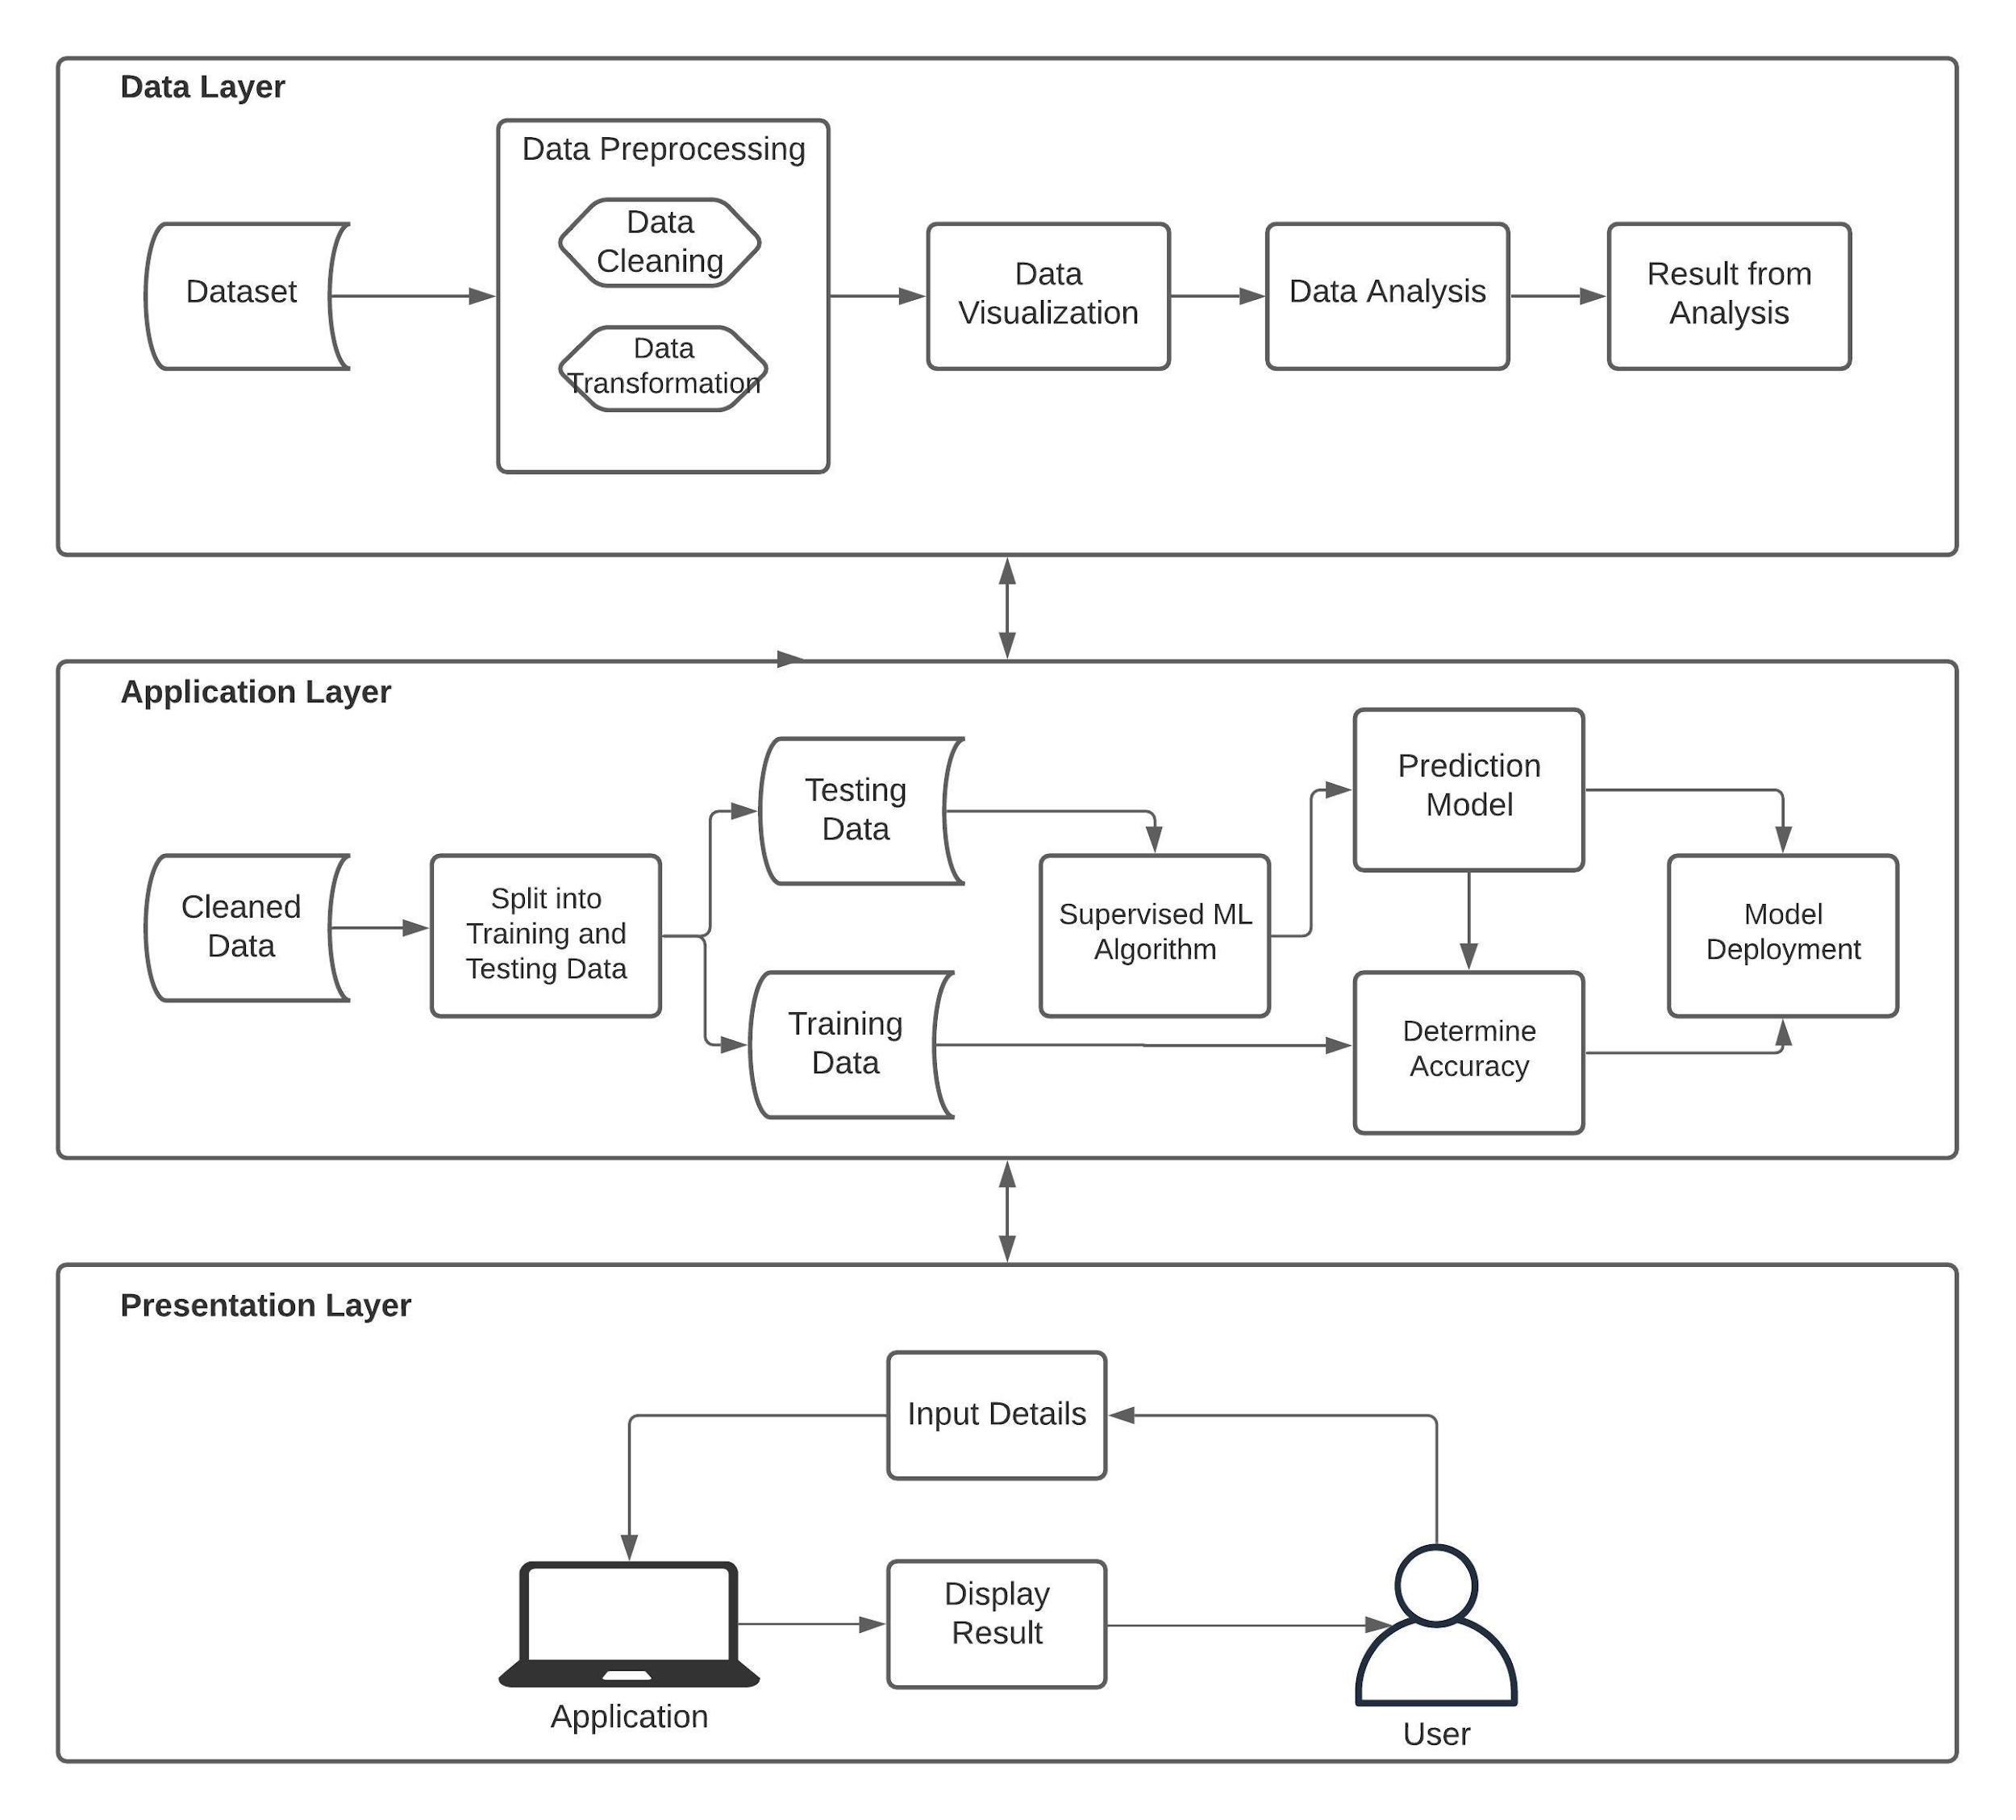
Fig. 1: Architectural Design for Proposed System

Slide 8
Techniques to be used
Data Collection: Collecting the dataset to be used.
Data Cleaning: Cleaning the dataset.
Data Visualisation: Visualise the data by plotting various graphs.
Data Analysis: Analyse the data and gain insights about it.
Select Machine Learning Algorithm: Select the best Supervised Learning Algorithm (KNN, SVM, Logistic Regression, Naive Bayes, Random Forest and Decision Tree).
Prediction Model: Create the Prediction Model.

Slide 9
References
Iyer, Aiswarya & Jeyalatha, s & Sumbaly, Ronak. (2015). Diagnosis of Diabetes Using Classification Mining Techniques. International Journal of Data Mining & Knowledge Management Process. 5. 1-14. 10.5121/ijdkp.2015.5101.
Kandhasamy, J pradeep & Balamurali, Saminathan. (2015). Performance Analysis of Classifier Models to Predict Diabetes Mellitus. Procedia Computer Science. 47. 45-51. 10.1016/j.procs.2015.03.182.
Nanda S, Savvidou M, Syngelaki A, Akolekar R, Nicolaides KH. Prediction of gestational diabetes mellitus by maternal factors and biomarkers at 11 to 13 weeks. Prenat Diagn. 2011 Feb;31(2):135-41. doi: 10.1002/pd.2636. Epub 2010 Dec 28. PMID: 21268030.
Barik, Shekharesh & Mohanty, Sambit & Mohanty, Surajit & Singh, Debabrata. (2021). Analysis of Prediction Accuracy of Diabetes Using Classifier and Hybrid Machine Learning Techniques. 10.1007/978-981-15-6202-0_41.
N., Yuvaraj & SriPreethaa, K.. (2019). Diabetes prediction in healthcare systems using machine learning algorithms on Hadoop cluster. Cluster Computing. 22. 10.1007/s10586-017-1532-x.
Mercaldo, Francesco & Nardone, Vittoria & Santone, Antonella. (2017). Diabetes Mellitus Affected Patients Classification and Diagnosis through Machine Learning Techniques. Procedia Computer Science. 112. 2519-2528. 10.1016/j.procs.2017.08.193.

